Slide 1
More CSS Selectors
Mr Mack 2021

Slide 2
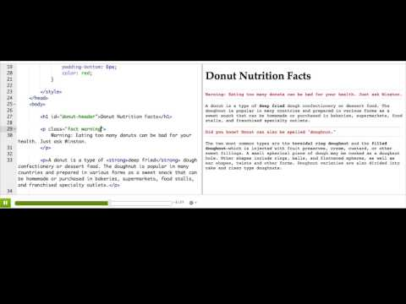
Using multiple CSS classes

Slide 3

Practice: A classy gallery
This webpage has three images in the body, but there are no styles yet.
We've defined a few CSS rules with class selectors at the top. Some of the rules change the size of the image, and others change the border.
Your challenge: is to add two class names to each image so that the sizes and borders vary from each other. Mix and match - try a few out!
Add multiple classes

Slide 4

Combining CSS class and element selectors

Slide 5
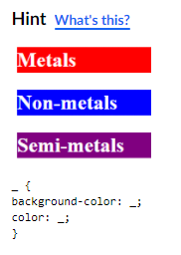
Practice: Classes of elements
This webpage describes one classification of elements in the periodic table: metals, non-metals, and semi-metals. It uses CSS rules with class selectors to color those words, both in the top paragraph and the headings.
Using what you learned in the last video, style the headings so that their background is the same color as their text. Then change the text color to white so that you can read it. For this step, start by styling the headings with the *'metal'* class.
Make more specific rules

Slide 6
Practice: Classes of elements
For this step, add a new rule for headings with the *'non-metal'* class.
Make more specific rules

Slide 7
Practice: Classes of elements
Now let's try doing the same thing for headings with the *'semi-metal'* class.
Make more specific rules

Slide 8
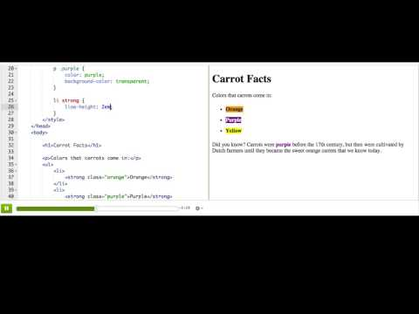
CSS descendant selectors

Slide 9

Practice: Descendants of Khan
This webpage describes Genghis Khan, an emperor who had many descendants, and includes a table with just a few of the emperors that descended from him. Add a rule that targets only the elements that have the 'emperor' class and are in the table. The rule should change the background color of those table cells.
Add descendant rules

Slide 10
Practice: Descendants of Khan
Now add another rule that targets only the elements that have the class name 'reign' and in the table. Like in the first step, the rule should change the background color of those table cells. Pick a different color than you picked for the other rule!
Add descendant rules

Slide 11
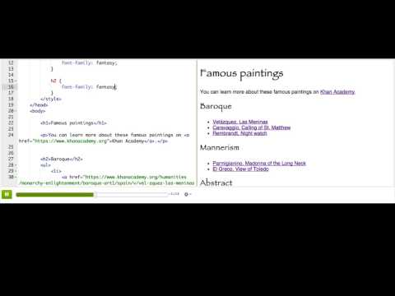
Grouping CSS selectors

Slide 12
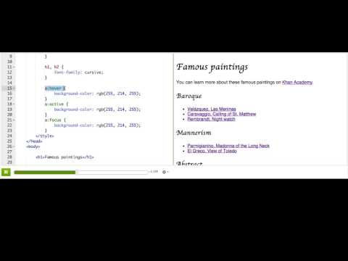
CSS dynamic pseudo-classes

Slide 13
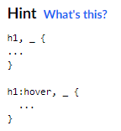
Practice: Grouped animals
This is a webpage about animal group names, with a few headings and images as examples.
There are already 2 CSS rules to style the <h1>s - one with a pseudo selector, and one without. Add another selector to each of the rules, so that they also style <h2>s.
Group the selectors

Slide 14
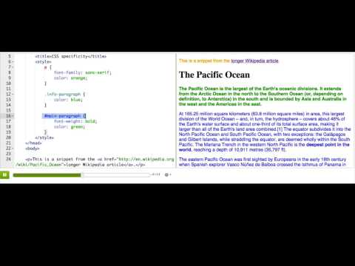
CSS specificity

Slide 15
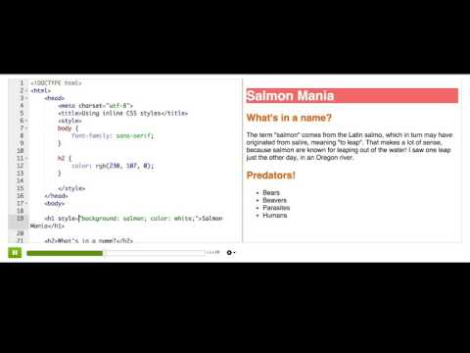
Using inline CSS styles

Slide 16
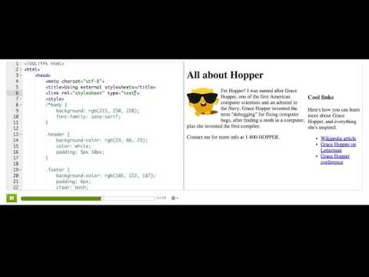
Using external stylesheets

